Slide 1
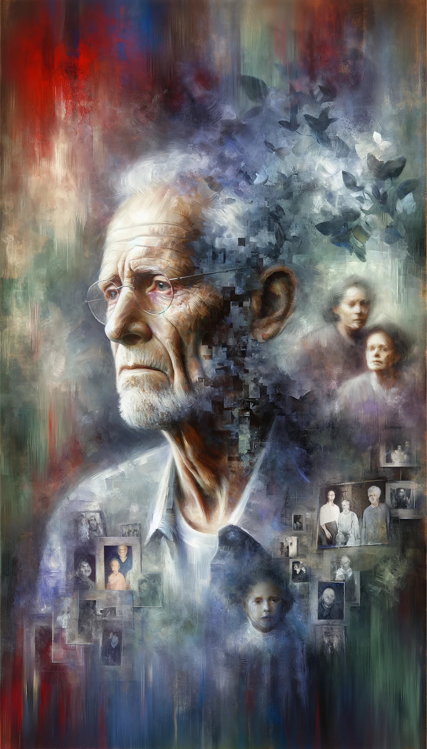
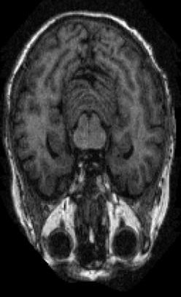
Transfer Learning with Popular Image Classification Models to Diagnose Alzheimer's Disease
By Dawson Haddox, Ben Williams, Michael Maddison, Will Balkan, and Brian Ng

Slide 2
Motivation

Slide 3
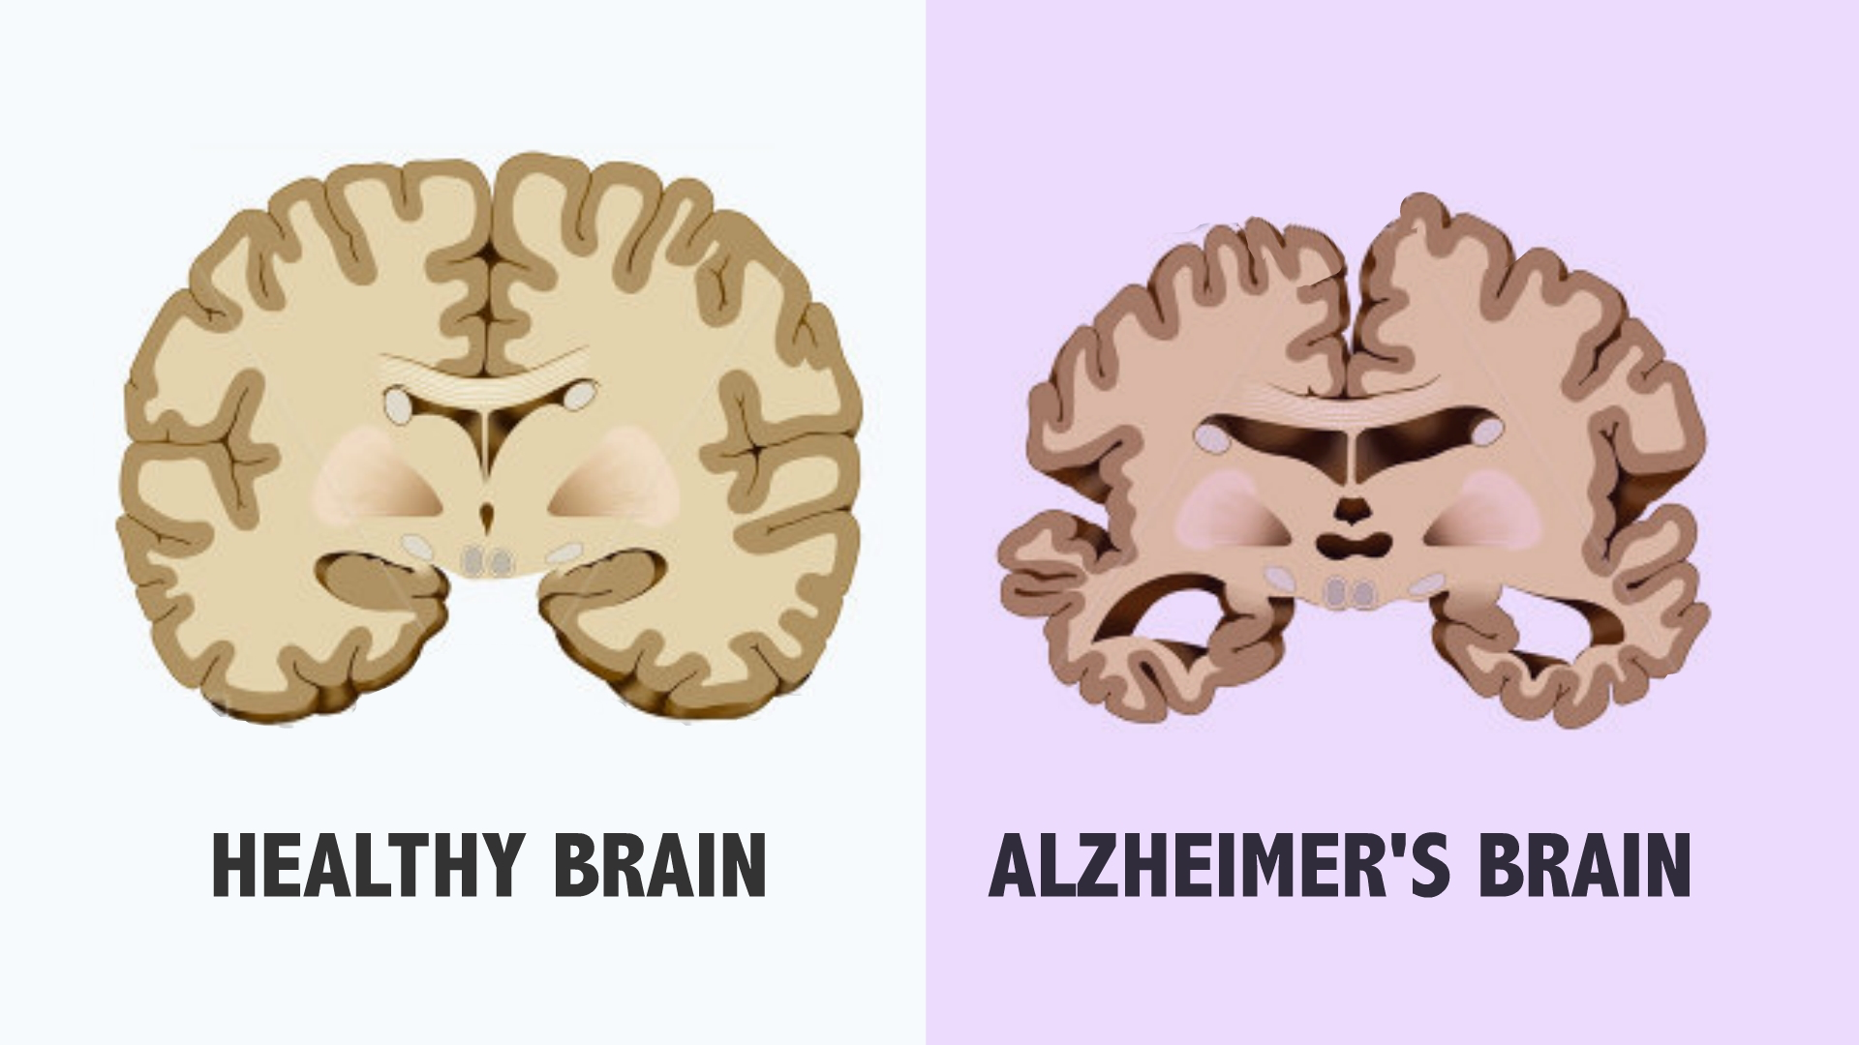
Why Alzheimer’s classification?
Alzheimer’s is a devastating neurodegenerative disorder that affects millions worldwide.
Diagnosing Alzheimer's, especially in the early stages, is challenging.
Training models that are better at classifying MRI images based on the severity of dementia will make diagnosis easier.

Slide 4
Why transfer learning?
Novelty & Interest
We noticed few papers were using transfer learning for this specific dataset
Recognize that MRI images are more complex than image classification for the pretrained models
Want to see how that would translate
Goal, limitations & hypothesis
Focused on exploring methods and testing what helps improve accuracy; less focused on beating existing models
Significant limitations in time and compute for an 80,000 image dataset
Given the context of our goal and limitations, transfer learning lets us significantly boost our model baseline so we can do meaningful testing of different methods while keeping compute costs low, letting us iterate more frequently

Slide 5
Addressing data leakage
The Kaggle OASIS dataset contains hundreds of scans per participant.
Many classification attempts split the dataset into train, test, and validation sets by image, not by participant.
This causes data leakage and inflates model accuracy, as the model is trained on images of the same brains it is later tested on.
We split the dataset by participant using the subject IDs in the image filenames, ensuring our results represent actual generalization better than previous attempts.

Slide 6
Problem Definition
Which fine-tuning strategies are most effective for adapting natural image models to Alzheimer’s classification?

Slide 7
Related Work

Slide 8
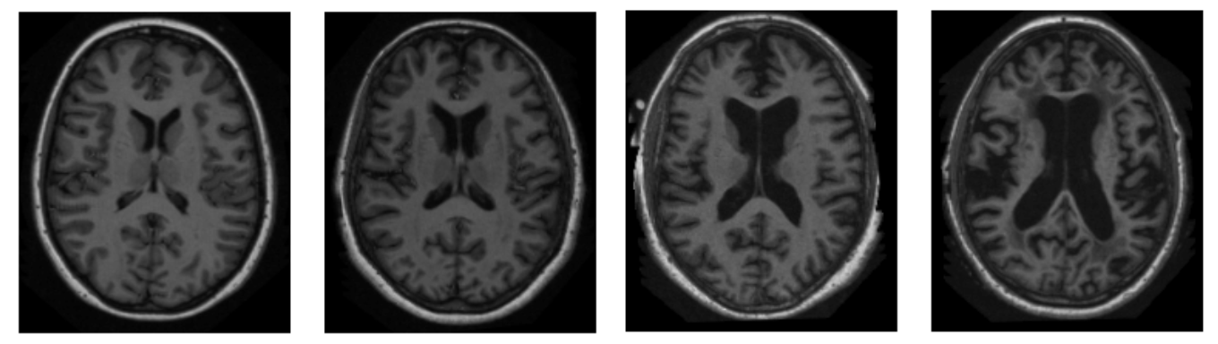
Related Work: Open Access Series of Imaging Studies (OASIS) Dataset
~80,000 MRI Images:
No Dementia
Very Mild Dementia
Mild Dementia
Moderate Dementia
Notes:
The dataset we used for this project is XXX.
There are multiple versions of this dataset. There are four on the website, but we used a version from Kaggle because X. This version doesn’t perfectly match any of those but primarily seems to take from OASIS 1
Most of the OASIS studies we’ll talk about used OASIS 3, often combined with the ADNI dataset.

Slide 9
Related Work: Leveraging a Novel Model Architecture
Develops novel model architecture for binary Alzheimer’s classification on another variant of the OASIS dataset. [S. Basheer et al., 2021]
Achieved an accuracy of 92.39%
Notes:
Many papers have developed novel model architectures for Alzheimer’s classification.
One recent example is X.

Slide 10
Related Work: Leveraging Existing Model Architectures Without Pre-Trained Weights
2D CNN method based on ResNet50 [Yadav, K. S. & Miyapuram, K. P., 2021]
AlexNet-based CNN classification model [Fuadah, Y. N. et al., 2021]
Notes:
Other papers have leveraged existing model architectures but trained them from scratch.

Slide 11
Novelty: Transfer Learning & Preventing Data Leakage
Many papers only attempt binary classification [S. Basheer et al., 2021]
Erroneous train/validation/test splits lead to data leakage [Aithal, Ninad]
Lack of exploration of true transfer learning [Yadav, K. S. & Miyapuram, K. P., 2021; Fuadah, Y. N. et al., 2021]
Notes:
We found various gaps in the current OASIS literature. While some models have achieved high accuracy, (1). Additionally, (2). Lastly, (3), starting with pre-trained weights and fine-tuning.
Aithal, Ninad. (2023; July). OASIS Alzheimer's Detection, Version 1. Retrieved May, 2023 from https://www.kaggle.com/datasets/ninadaithal/imagesoasis/data.
Nikhil J. Dhinagar, Sophia I. Thomopoulos, Priya Rajagopalan, Dimitris Stripelis, Jose Luis Ambite, Greg Ver Steeg, Paul M. Thompson, "Evaluation of transfer learning methods for detecting Alzheimer’s disease with brain MRI," Proc. SPIE 12567, 18th International Symposium on Medical Information Processing and Analysis, 125671L (6 March 2023); https://doi.org/10.1117/12.2670457

Slide 12
Methods and Results

Slide 13
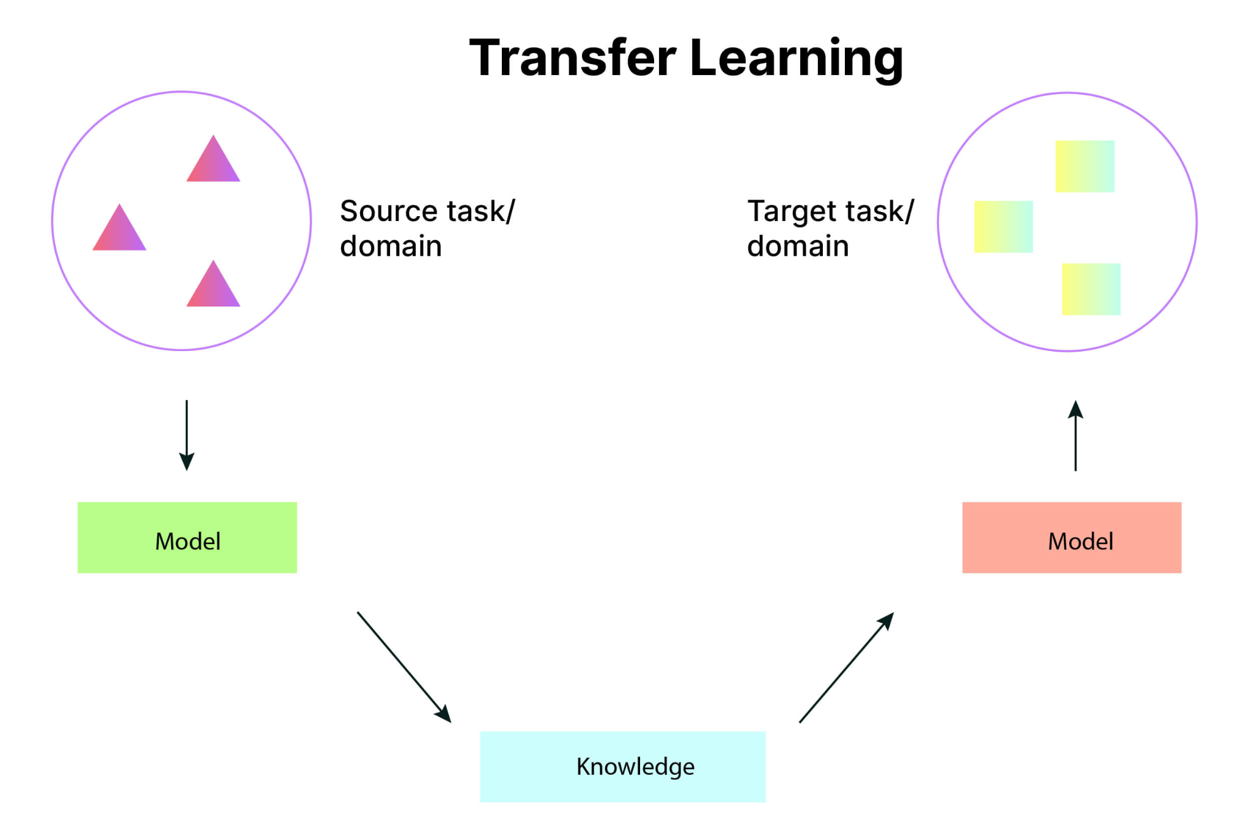
Transfer Learning
Transfer learning is a technique where a pre-trained model is used as the starting point for a different but somewhat related task.
Speeds up model development and leverages previously acquired knowledge.
An Introduction to Transfer Learning in Machine Learning
Notes:
As I stated, our proposed method method is transfer learning. We explored the basics of transfer learning in class. It’s XXX.

Slide 14
Data Selection and Train/Test/Validation Split
Removed moderate dementia images due to only two participants.
Subset to 40% of the data due to computational restraints for faster fine-tuning.
Random Subset: Randomly selected 40% of the data.
Image Entropy Subset: Selected top 40% highest entropy images. No to slightly significant improvements.
Split data into train/test/validation sets by participants to prevent data leakage.
Notes:
Before modeling, we decided to subset and split the data.
First, (1).
Second, (2). We wanted to run a lot of experiments, and we wouldn’t have been able to do this if we fine-tuned our models on so many high resolution images.
Third, (3).

Slide 15
Preprocessing
Set random seed to effectively compare modifications and ensure reproducibility of results.
Applied resize, random crop, or central crop transformations to meet conventional input dimensions for each model. No significant variation in results.
Hippocampus segmentation to focus on a brain region associated with Alzheimer’s and memory. Slight improvements to validation loss and accuracy.
Notes:
We experimented with various transformations in hopes of improving our models.
First, and this applies to more than preprocessing, (1).
Then, (2) and (3).

Slide 16
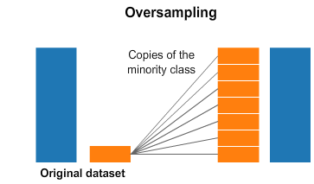
Oversampling, Data Trimming and Balancing
Class Imbalance: 26,888 non-demented, 5,490 very mild dementia, 2,000 mild dementia.
Oversampling: Duplicating images from underrepresented classes to balance the dataset.
Data Trimming and Balancing: Cutting images from the overrepresented class and augmenting images from underrepresented classes to achieve balance.
Neither oversampling nor data trimming and balancing had a significant impact on validation loss and accuracy.
Practicus AI (2018). Handling Imbalanced Datasets in Deep Learning

Slide 17
Hyperparameter Tuning, Optimization
Experimented with different step sizes, number of epochs, batch sizes, random seeds, and early stopping hyperparameters to determine those that often worked best.
Experimented with the Adam and SGD optimizers. Results were best using the Adam optimizer.
Experimented with fine-tuning the top versus the top two layers. Results were best when only fine-tuning the top layer.

Slide 18
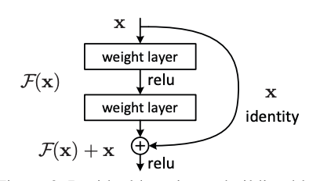
ResNet
Takes advantage of residual layers to prevent degradation using identity mapping, allowing for deeper networks
Why:
Repeated identity mappings allow the fine-tuning to learn more about our specific dataset, and not ImageNet
Best Result:
78.83% on test set
He et al. Deep Residual Learning for Image Recognition. 2015.

Slide 19
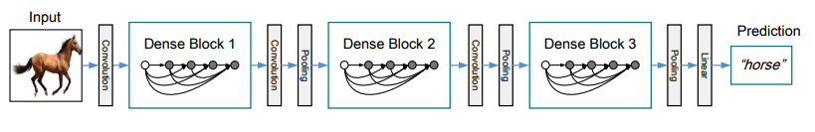
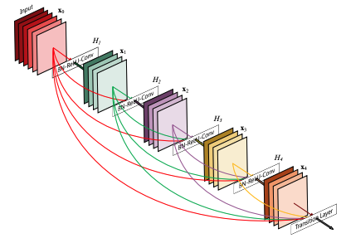
DenseNet
Takes a different approach to preventing degradation, early layers pass information to many future layers in many Dense Blocks
Why:
More information about our specific dataset is preserved until the end, allowing us to learn more about our specific dataset
Best Result:
79.19% accuracy on test set
Huang et al. Densely Connected Convolutional Networks. 2018.

Slide 20
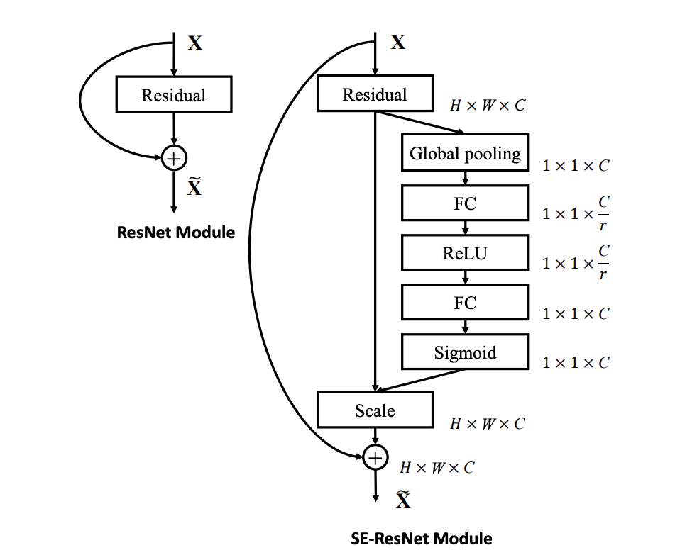
SqueezeNet
Uses fully connected layers inside convolutional blocks. Also takes advantage of residual layers
Why:
SqueezeNet is very compact, so fine tuning just the final classifying layer is very significant
Best Result:
76.31% on test set
Hu et al. Squeeze-and-Excitation Networks. 2019.

Slide 21
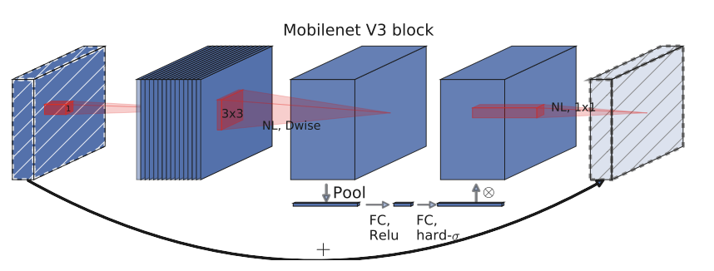
MobileNet
Combines residual blocks and squeeze and excite layers to create bottleneck layers, slowing down the increase in dimensionality
Why:
This is a very lightweight, fast model that we could modify a larger part of
Best Result:
76.55% accuracy using MobileNet Small on the test set
Howard et al. Searching for MobileNetV3. 2019.

Slide 22
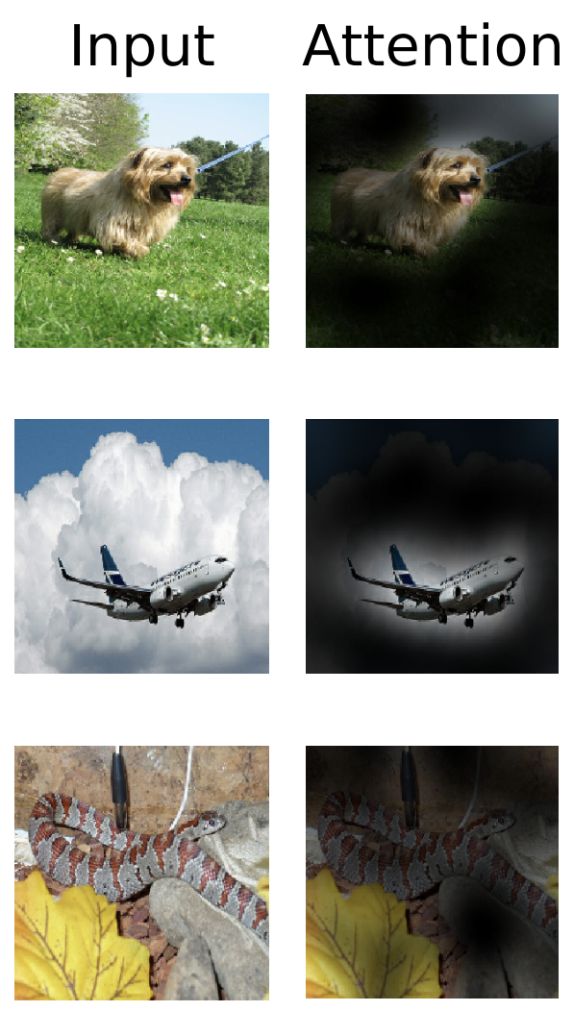
Vision Transformer
Leverages the transformer architecture used for NLP with minimal modifications
Why:
This model’s structure differs entirely from our other experiments, and it may better find the important pieces of the image
Best Result:
80.80% accuracy on the test set
Dosovitskiy et al. An Image is Worth 16x16 Words: Transformers for Image Recognition at Scale. 2021

Slide 23
Results Summary
Model Name | Test Accuracy | Test Loss
ResNet | 78.83% * | 0.5304
DenseNet | 79.19% * | 0.4666
SqueezeNet | 76.31% | 0.7884
MobileNet Small | 76.55% | 0.5468
MobileNet Large | 75.97% | 0.6006
Vision Transformer | 80.80% * | 0.4458

Slide 24
Conclusions
Efficacy:
Our models struggled to surpass the accuracy from just weighted guessing, and when they did (such as for the Vision Transformer), it was by a small margin. Cropping and resizing while not oversampling proved to be the most effective training method.
Possible Limitations
Our model choices were heavily influenced by our limited computational power. Deeper models might have performed better, but this is uncertain.
Next Steps:
Rather than just fine-tuning the final layers, training a complete model on the dataset, though more expensive, would likely have much more success

